Slide 1




SoftUni 3.0
Welcome to Software University
SoftUni Team
Technical Trainers
Software University
http://softuni.bg

Slide 2
Welcome to SoftUni
Software University (SoftUni)
High-quality education, profession and jobs for software engineers
4 professions: 20+ practical courses → ~ 2 years
Bachelor diploma: 2 years @ SoftUni + 1-2 years at partner university (MTM College, VFU, BFU)
Study onsite and online (with onsite exams)
Jobs in Bulgaria and abroad
Free start for everyone
New Programming Basics course each month

Slide 3
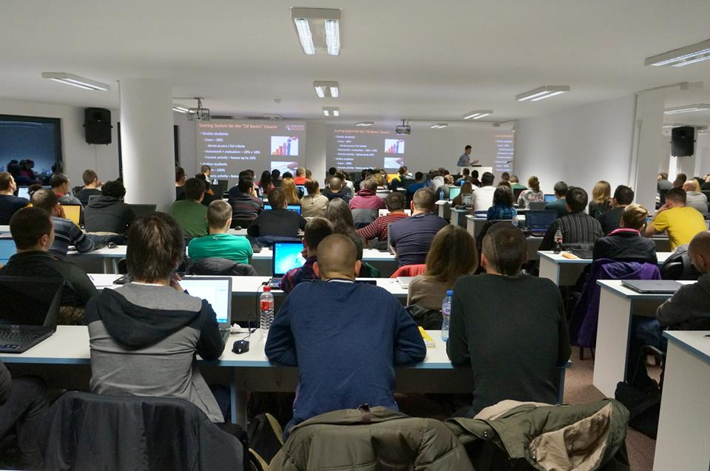
Specialized Courses
Students take additional credits from specialized courses
Multimedia & Office Apps
Digital Marketing
Data Structures
Algorithms
Linux Programming
Many others …
These courses are open for everyone

Slide 4
Diplomas and Certificates
Course Certificates
Every course, passed with grade >5.00 – granted Certificate
Professional Diploma from SoftUni
JavaScript Developer: >130 credits
PHP Developer: >130 credits
C# Web Developer: >170 credits
Java Web Developer: >170 credits

Slide 5
Jobs
SoftUni helps the students to start a job in the IT industry
Contracts with 60+ companies for hiring students
Best students study free with scholarship
Students with high results choose between many employers
Students with bad results are not guaranteed to start a job
Internships in Germany and USA

Slide 6

Curriculum and Schedule

Slide 7
SoftUni: Curriculum, Modules, Timeline
Free Entry
Module
9
Programming Basics
4 months
Coding for beginners
Programming Basics
>50% exam Enter SoftUni
>97% exam – Scholarship
Admission Exam
Software Technologies
4 months
Orientation
Module
12
HTML + JavaScript
PHP + MySQL
C# Web
Java Web
Select desired profession
Professional
Modules
8-24 months
Professional Qualification

Slide 8
JavaScript / PHP Developer Profession
JS Core
PHP Fundamentals
2 x 4 months
mandatory
27
24
MEAN Stack
PHP Web
>70 credits
Start a job
27
27
9
9
Web Basics
Web Basics
2 x 4 months
essential
courses
Data Structures & Algo
JS Core
24
27
IT Basics
9
IT Basics
9
>130 credits
Diploma
Embedded & Mobile
Embedded & Mobile
9
9

Slide 9
C# / Java Web Developer Profession
C# Fundamentals
Java Fundamentals
3 x 4 months
mandatory
courses
27
27
DB Fundamentals
DB Fundamentals
27
27
>100 credits
start a job
C# Web
Java Web
27
27
JS Core
JS Core
2 x 4 months
essential
courses
27
27
Data Structures & Algo
Data Structures & Algo
24
24
Web Basics
Web Basics
9
9
>170 credits
Diploma
Embedded & Mobile
Embedded & Mobile
9
9

Slide 10
SoftUni Credit System
Each course grants specific amount of credits
Depends on number of lessons
Depends on complexity
Credits are given proportionally, based on the course grade
Grade 3.00 → 1/3 of the course credits
Grade 5.00 and above → full course credits
Example:
3.73 on C# OOP course → 5.19 credits (out of 9 total)

Slide 11
Class of March 2016 - Schedule
March-April 2016
Java Fundamentals / Teamwork and Personal Skills
May-August 2016
C#/Java Fundamentals – C#/Java Web Developer Profession
Software Technologies – Orientation module
September-December 2016
DB Fundamentals – C#/Java Web Developer Profession
JavaScript Core – JavaScript/PHP Developer Profession

Slide 12
March-April 2016 – Courses, Exams
Java Fundamentals – March 2016 (14 March – 12 April 2016)
Group I: Monday/Wednesday 14:00-18:00
Group II: Monday/Wednesday 18:00-22:00
Teamwork Defense: 14 April 2016 10:00-18:00
Exam: 17 April 2016 09:00-15:00
Teamwork and Personal Skills – March 2016
18 March – 22 April: Friday 18:00-22:00
Teamwork Defense: 28 April 2016 10:00-18:00

Slide 13
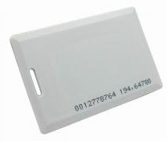
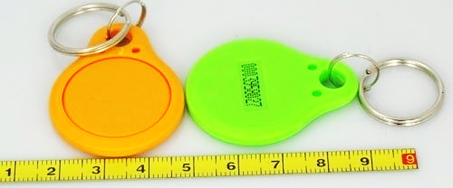

Check-In @ SoftUni
Onsite students at SoftUni should check-in when they come
We use standard 125 KHz RFID chips / cards
Check-in device (reader) is available at the SoftUni reception
Use your own chip / card or take a chip from SoftUni

Slide 14


Your RFID Chip
Students can either
Take RFID chip from SoftUni
Or use their own chip / card
Register your chip number in your SoftUni profile: https://softuni.bg/users/profile/show
Check-in at the reception every time when you come
See your last visits in your profile: https://softuni.bg/users/profile/show

Slide 15
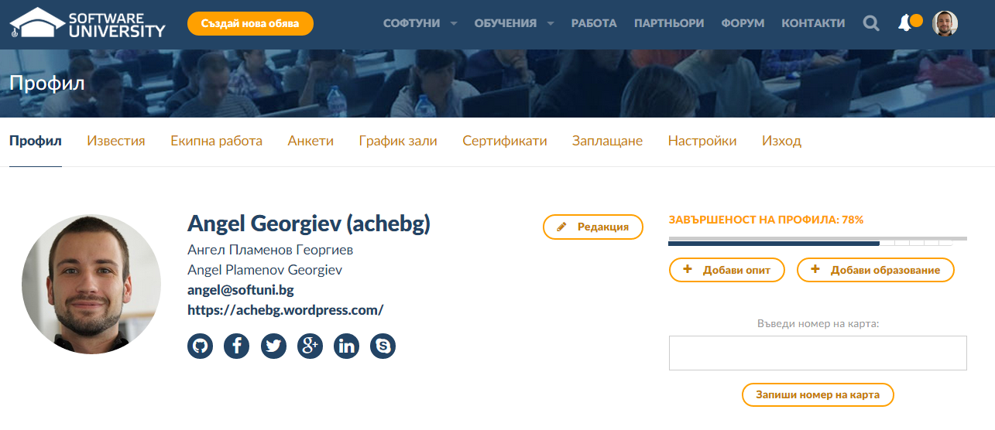
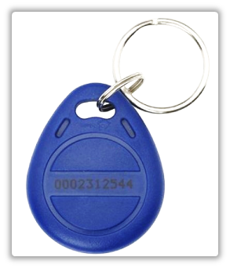
Registering Your Chip – Step 1
Enter the chip number in this box
This is your chip number

Slide 16
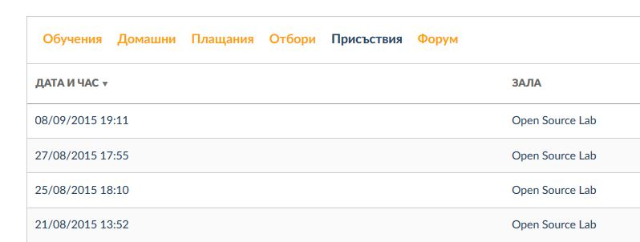
Registering Your Chip – Step 2
View your latest attendances
Go to softuni.bg/users/profile/show
or just navigate to your profile

Slide 17
Free Licenses from Our Partners
SoftUni provides free educational licenses to all its students
From JetBrains
ReSharper – powerful add-on for Visual Studio for C# developers
WebStorm – powerful IDE for JavaScript developers
PhpStorm – powerful IDE for PHP developers
From SuperHosting.bg
Free hosting for your site / blog
From Microsoft
Free access to Windows Azure cloud

Slide 18










Welcome to Fundamentals Level
https://softuni.bg/

Slide 19
License
This course (slides, examples, demos, videos, homework, etc.) is licensed under the "Creative Commons Attribution-NonCommercial-ShareAlike 4.0 International" license
Attribution: this work may contain portions from
"Fundamentals of Computer Programming with C#" book by Svetlin Nakov & Co. under CC-BY-SA license
"C# Part I" course by Telerik Academy under CC-BY-NC-SA license

Slide 20




Free Trainings @ Software University
Software University Foundation – softuni.org
Software University – High-Quality Education, Profession and Job for Software Developers
softuni.bg
Software University @ Facebook
facebook.com/SoftwareUniversity
Software University @ YouTube
youtube.com/SoftwareUniversity
Software University Forums – forum.softuni.bg

